Slide 1
CSE303 Project Presentation
Done by
Mohammad Azwad Saadat Sarwar 1910902

Slide 2
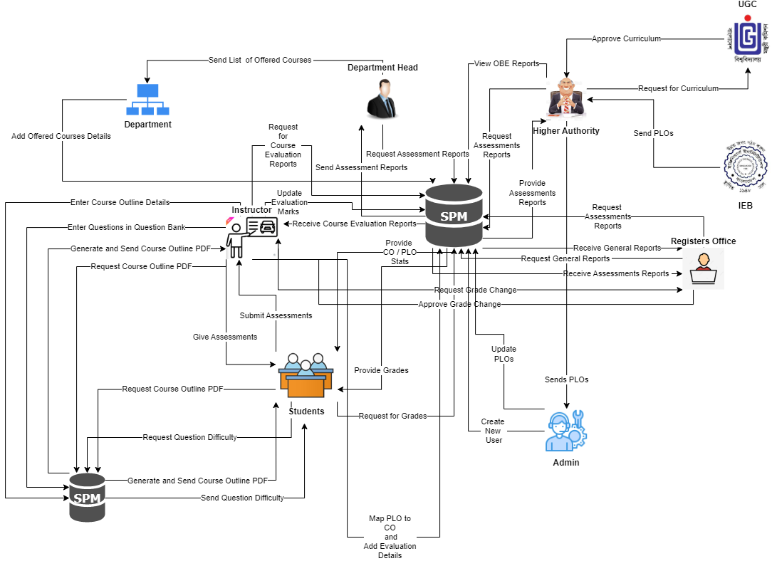
Rich Picture
(AS-IS)

Slide 3
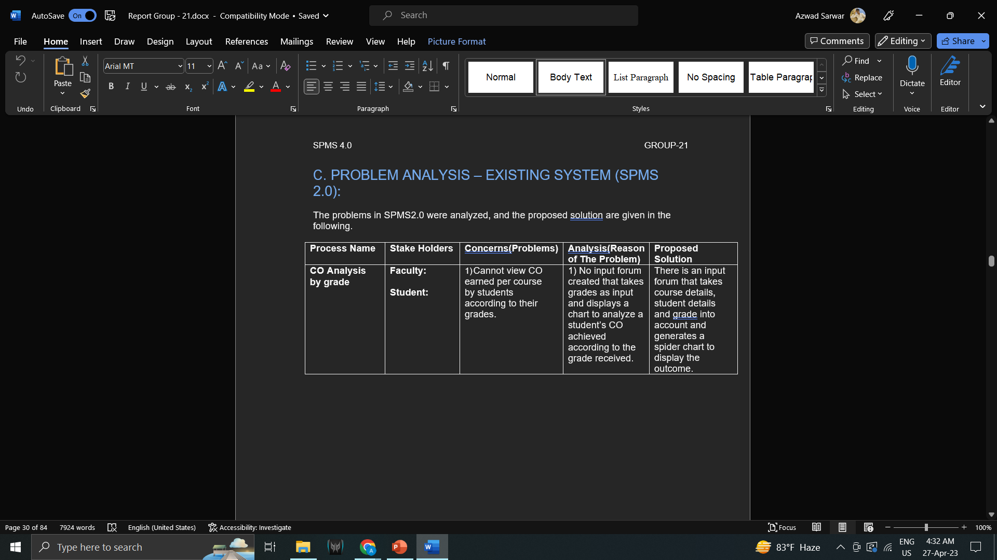
Problem Analysis

Slide 4
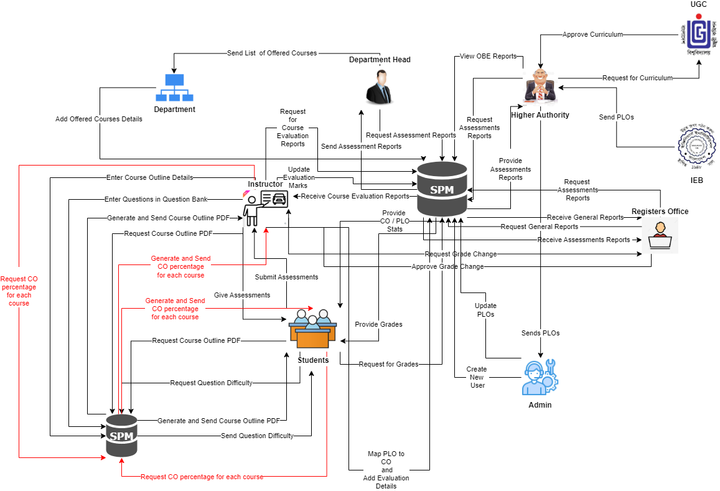
Rich Picture
(TO-BE)

Slide 5
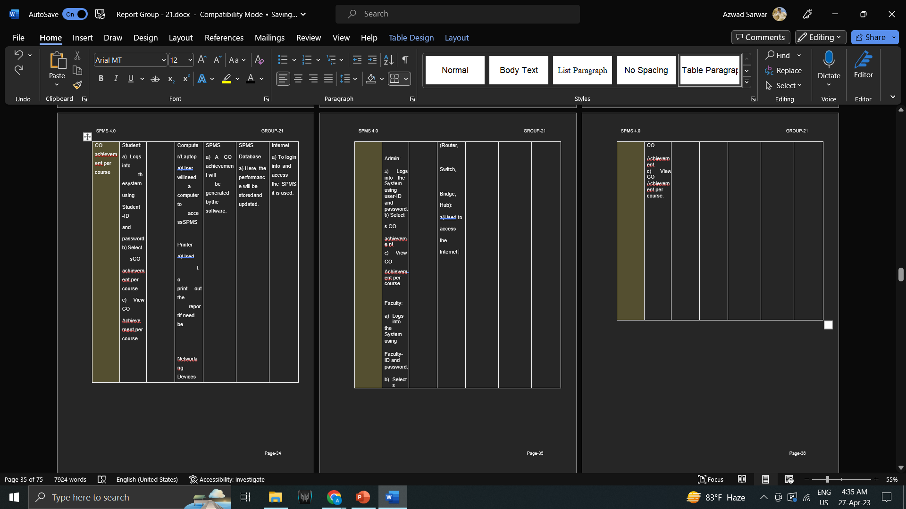
Six Element Analysis - TO BE System

Slide 6
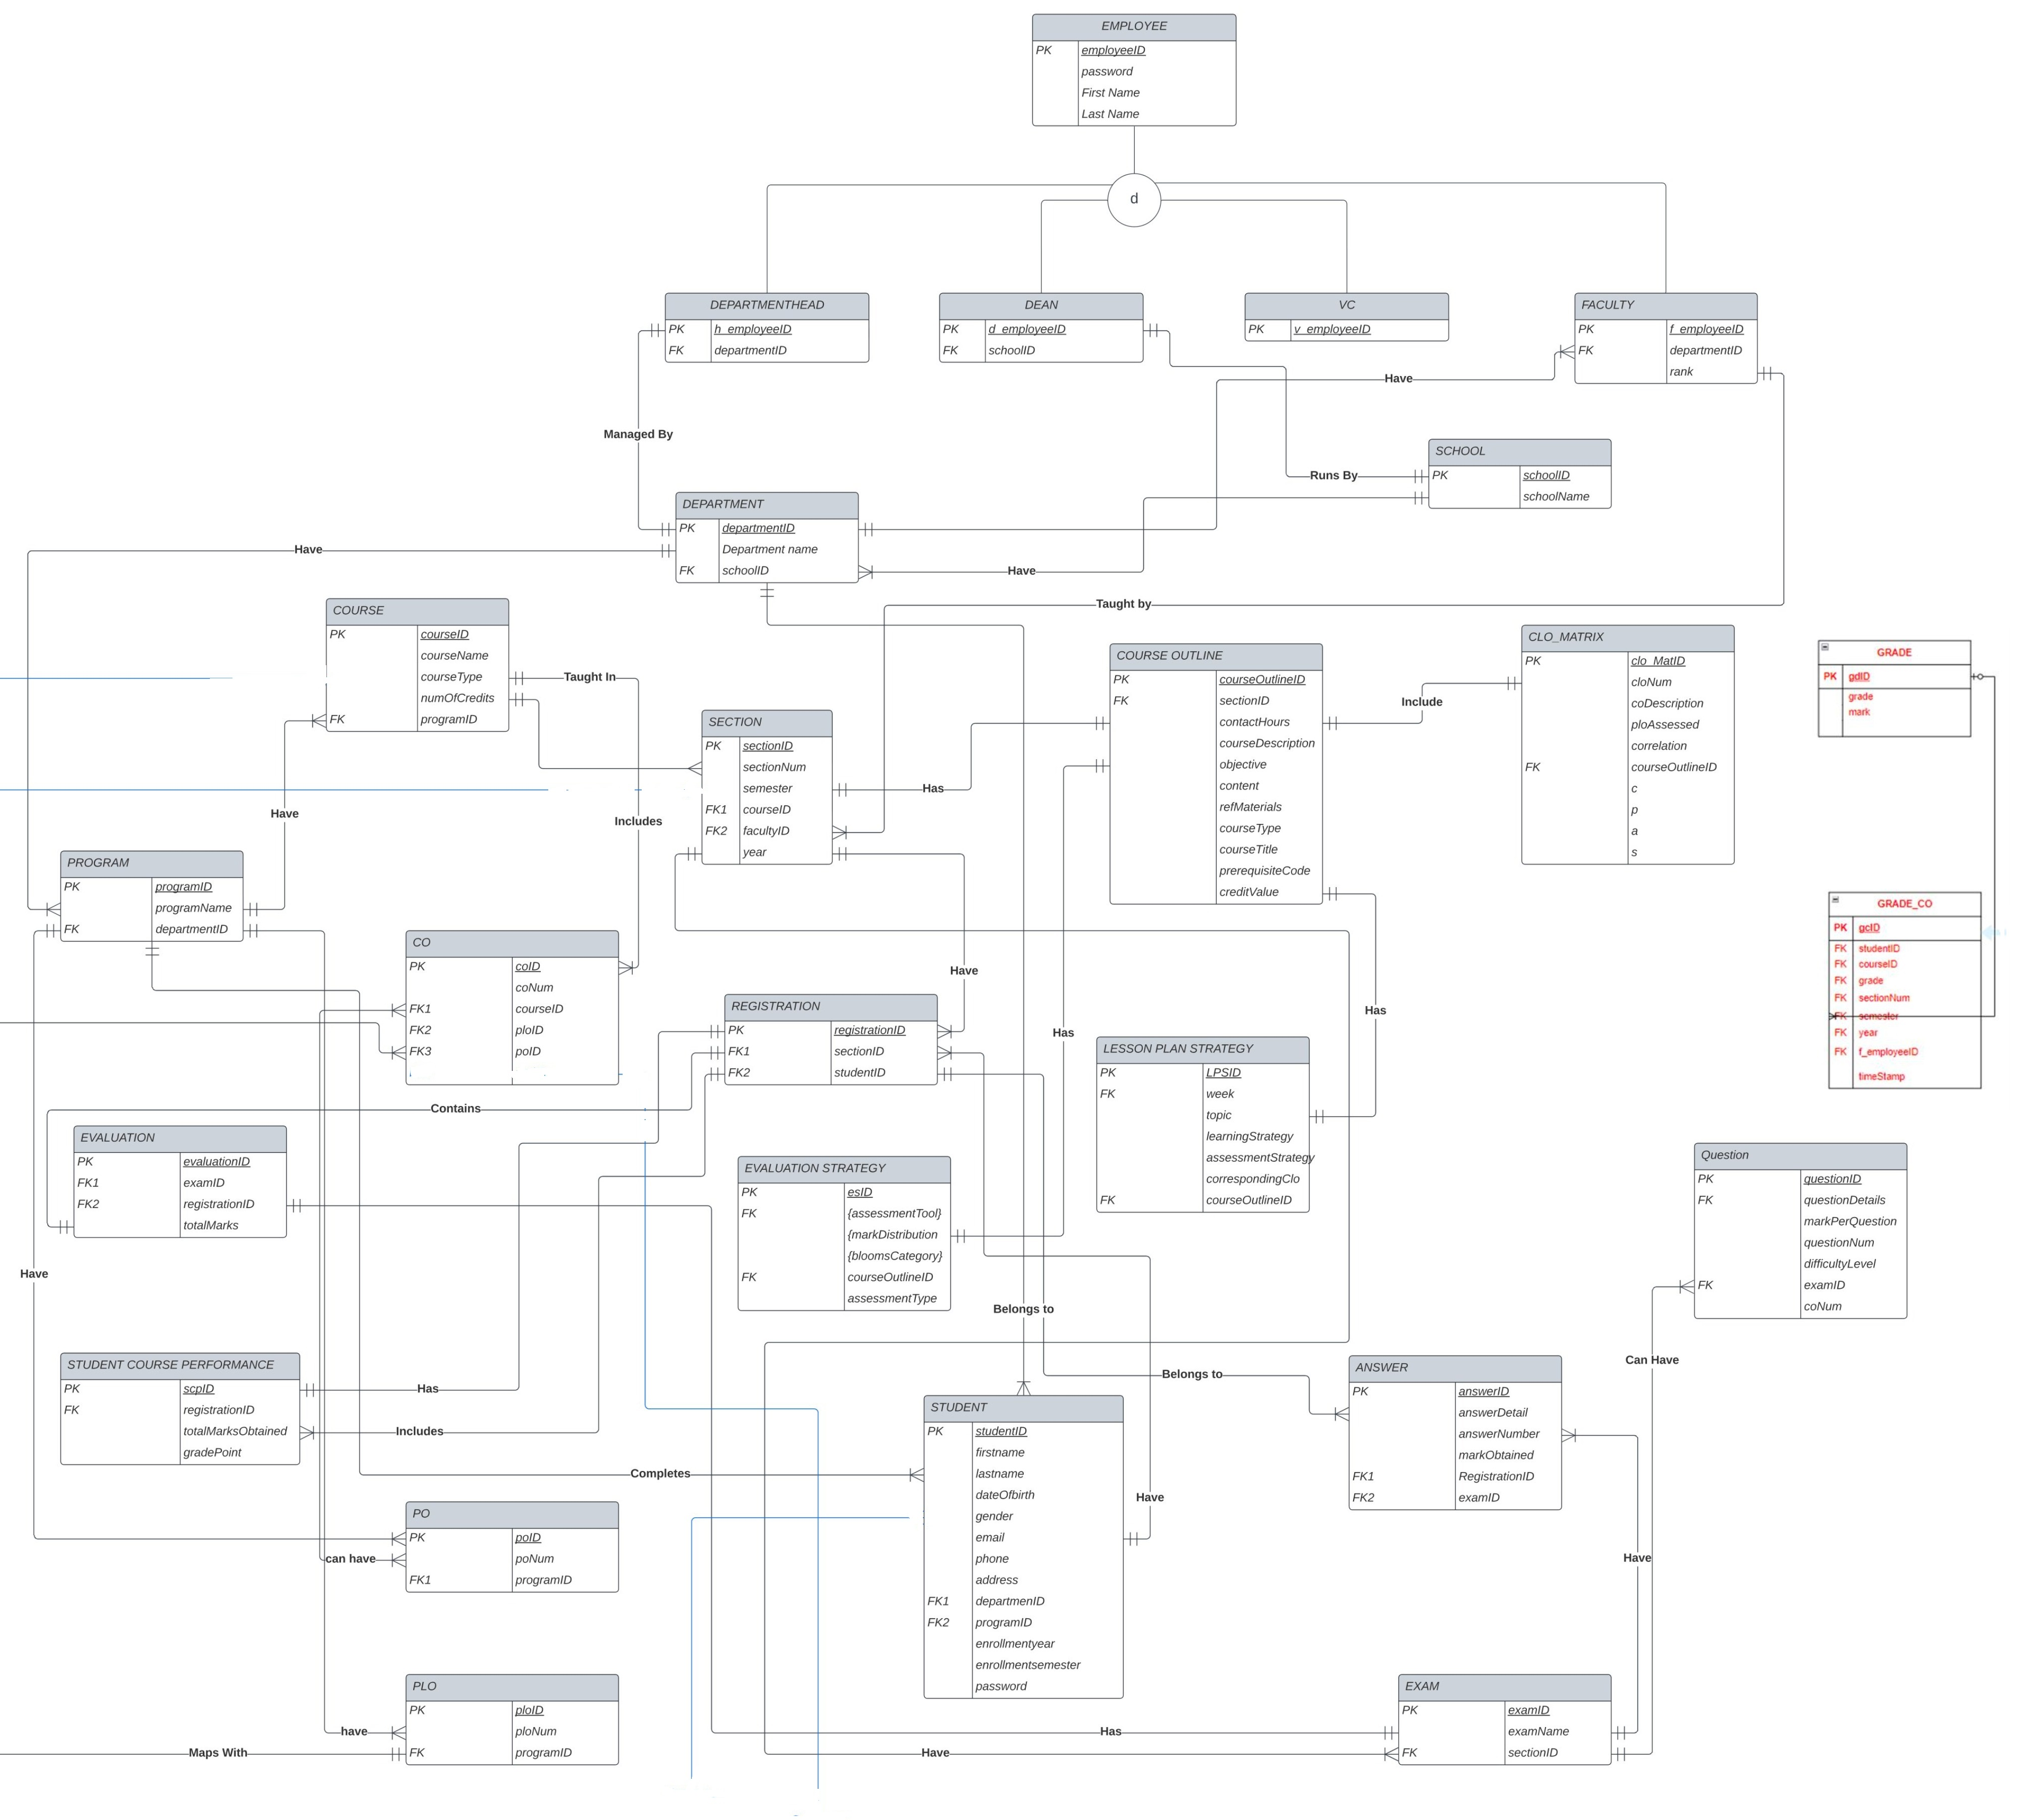
EERD

Slide 7
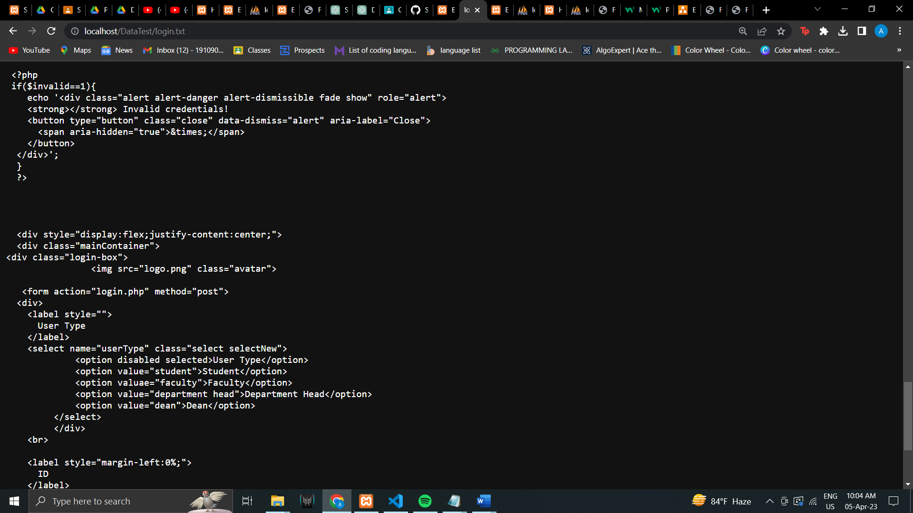
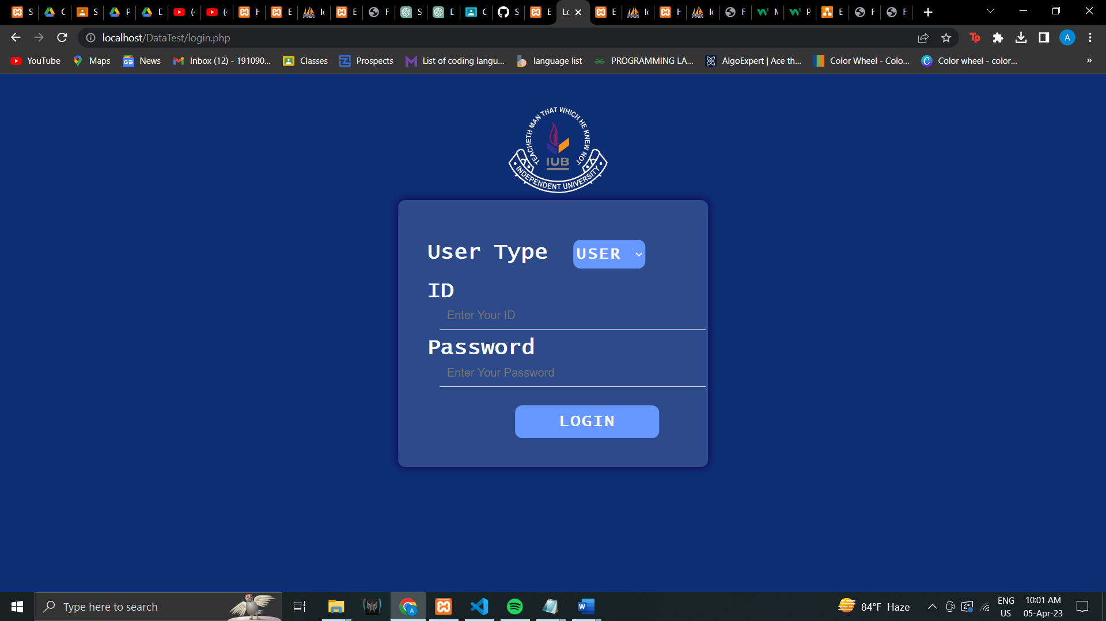
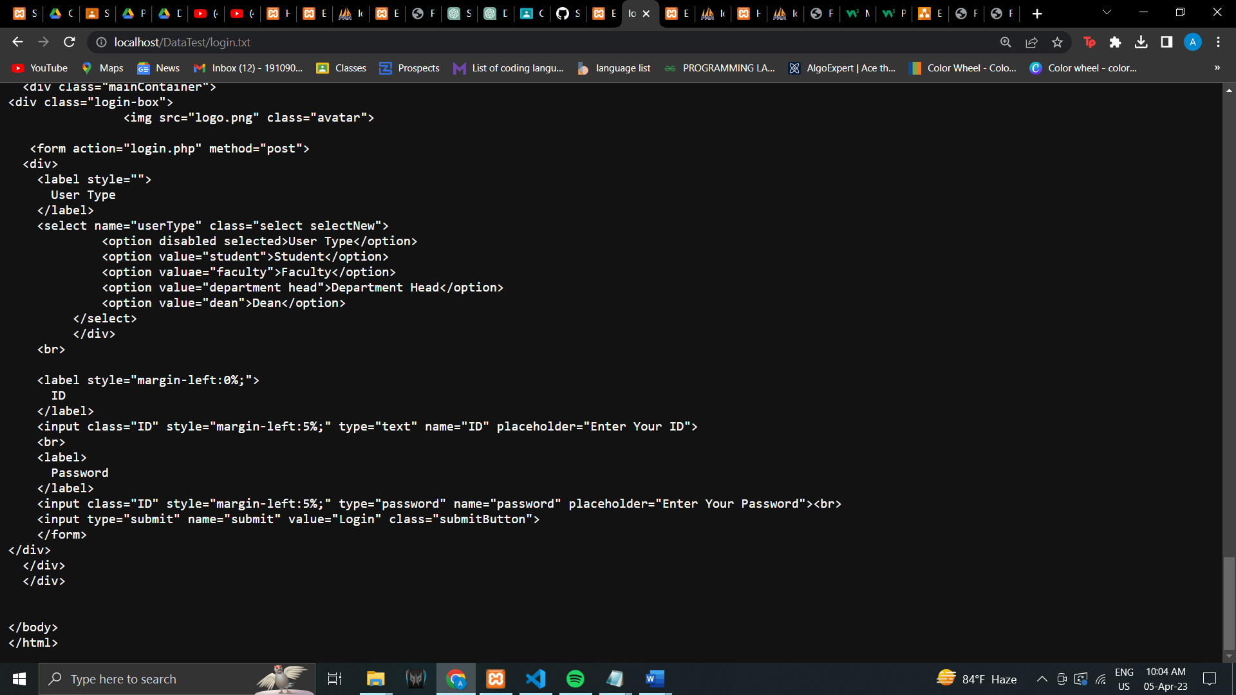
Input Forms

Slide 8
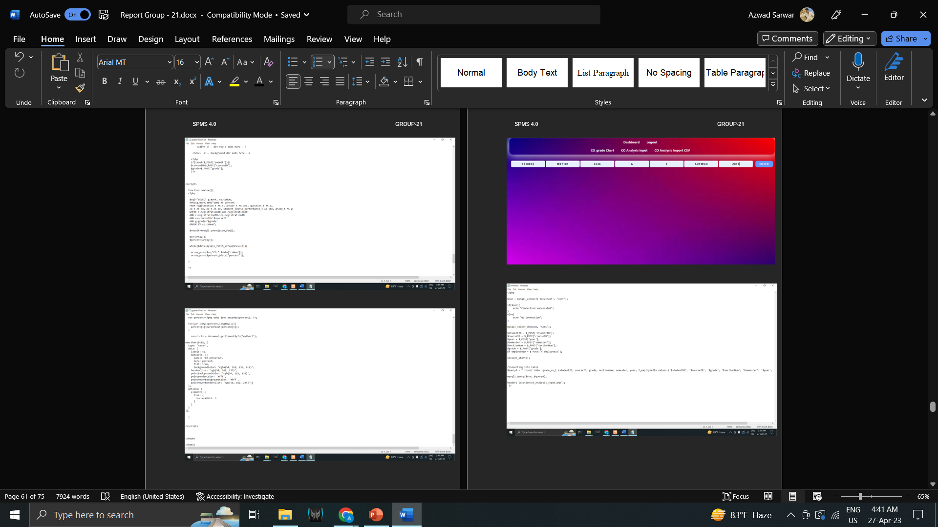
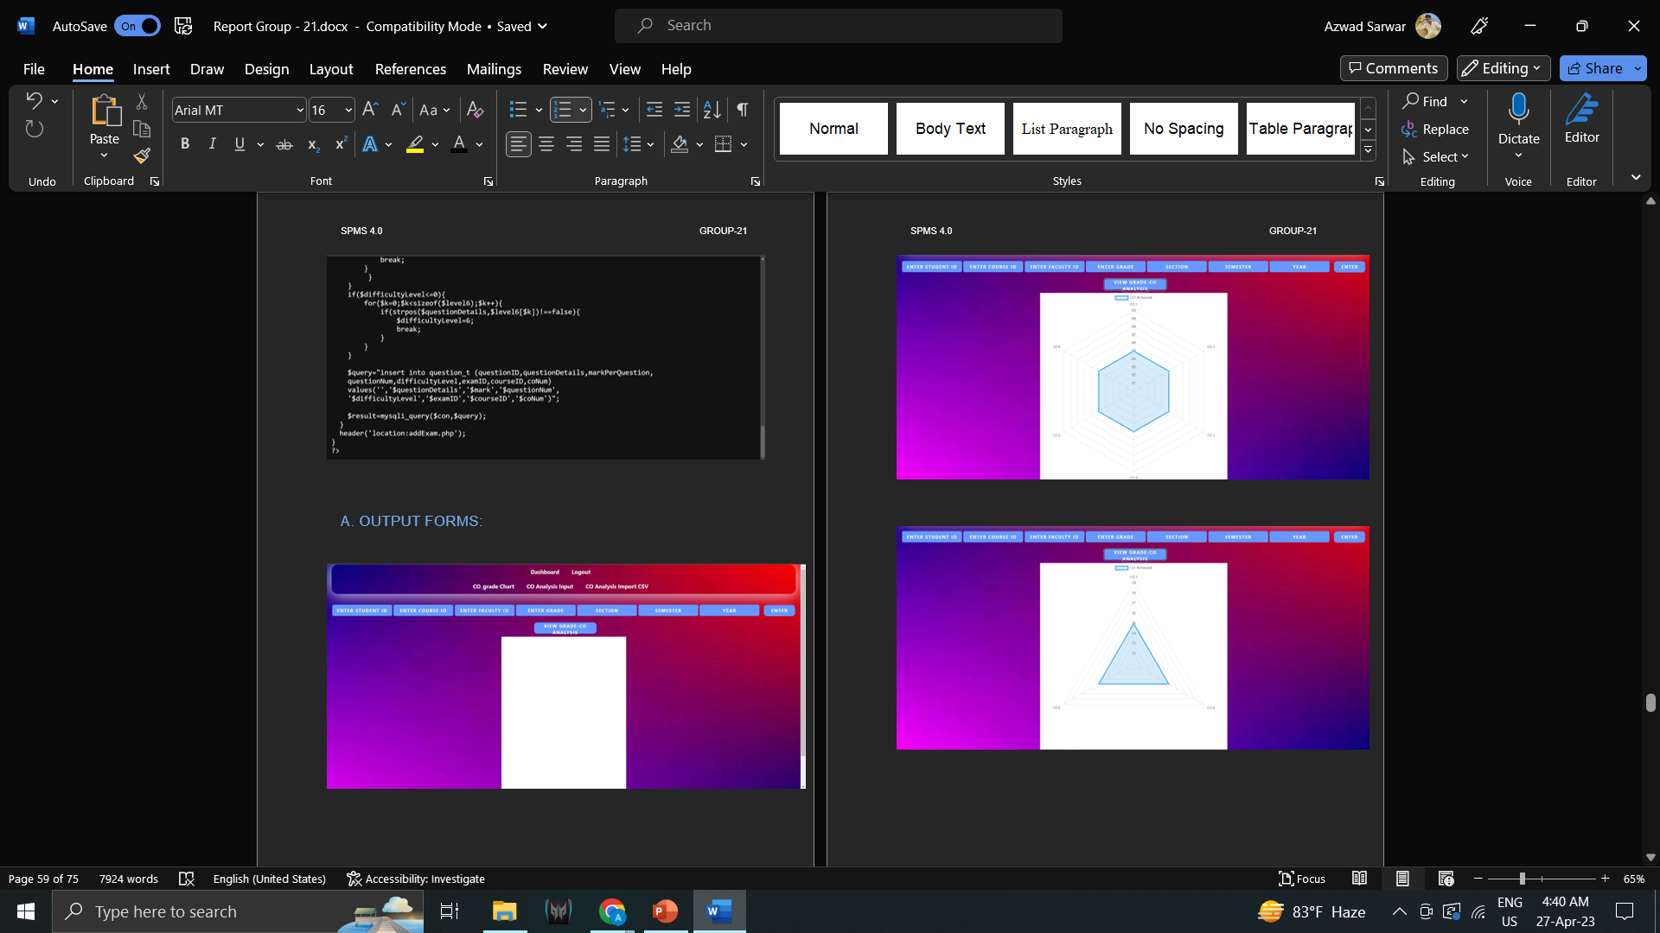
Output Forms

Slide 9
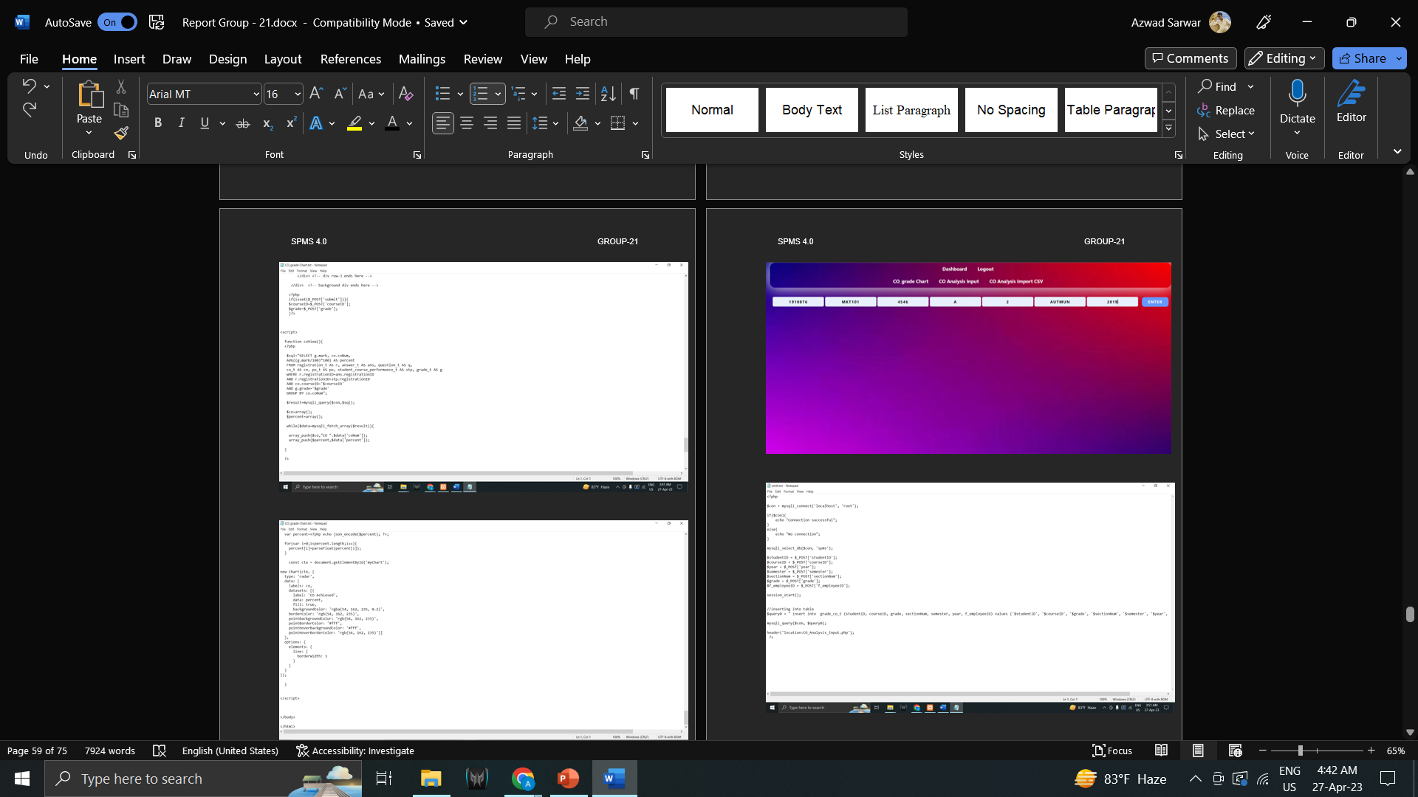
Output Forms

Slide 10
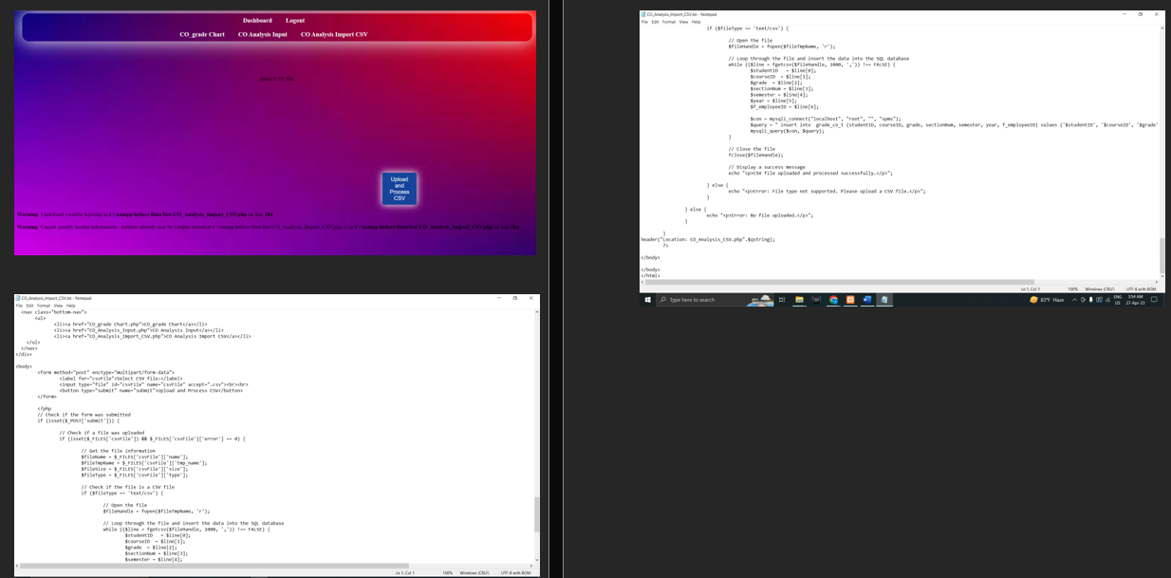
Output Forms

Slide 11
Thank you!

